Slide 1
Hand gesture recognition
Presenter:藍泓景
E-mail:r12922134@ntu.edu.tw
Phone:0908013956

Slide 2
The Concept of Smart Glasses
Hardware
Virtual Reality (VR) and Augmented Reality (AR)
Interacting with Smart Glasses

Slide 3
Virtual Reality (VR) and Augmented Reality (AR)
Mixed Reality (MR) is a “virtuality continuum”,
AR is a subset of MR.
(Milgram & Kishino, 1994)

Slide 4
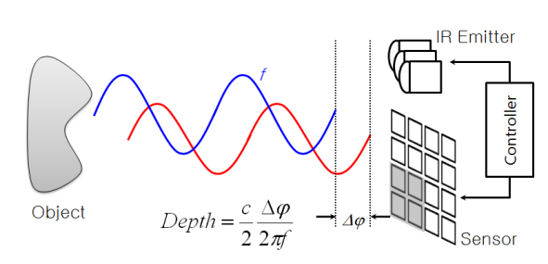
The Method of Depth Estimation
Time of Flight
Resolving distance between the camera and the object for each point of the image.
Provided by a laser or a Light Emitting Diode (LED).

Slide 5
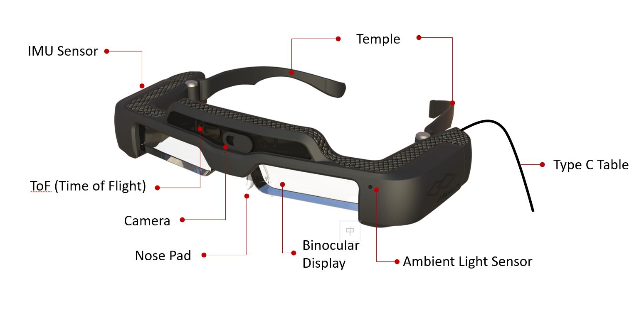

Our Hardware Configuration
Jorjin J7EF Plus
FoV: ${29.6}^{∘}$ (horizontal)
Display resolution: 1080p
Inter-Pupillary Distance (IPD): 65 mm
Sensors:
8 MP RGB camera
64 (=8 x 8) pixels ToF depth camera
IMU
Others:
Tethered
USB and DisplayPort protocols
Supports stereo display
Smart glasses: Jorjin J7EF Plus
Smartphone: Sony Xperia 1 II
Operating System (OS): Android 12

Slide 6
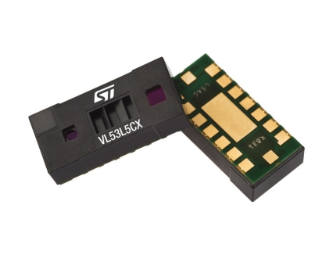
Sensor Decision
STMicroelectronics VL53L5CX
Resolution: 8 x 8 (=64) pixels
Range: 2 cm to 400 cm
FoV: ${45}^{∘}$ (Horizontal and Vertical)
Sample rate: 15 FPS at 8 x 8 pixels
Pros of using ToF:
Eliminate background noise
Detect motions perpendicular to the image plane

Slide 7
Overview
Notes:
兩種座標系統對應/校正
手部資訊:手指彎曲程度,手部rotation x y z資訊

Slide 8
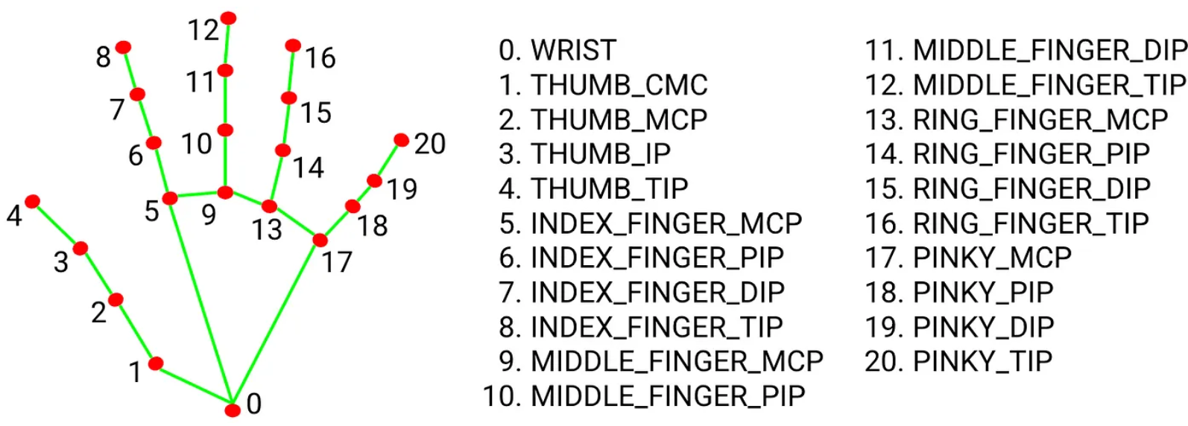
Method
Notes:
Mediapipe 基於camera拍到的照片
搭配多媒體機器學習應用辨識手上的landmark
mediapipe是利用 2.5D representation Google團隊使用了一種近似3D hand pose的方法：一樣預測關鍵點在影像上的2D位置，並且額外預測各個關鍵點的相對深度 (local depth)，即相對某個關鍵點的深度差。在大部分的情況下，手腕處或是手掌中心會被設為相對深度的基準點，也就是這個位置的深度視為零。這種表示相對深度的方法被統稱為2.5D表示法。
留言
接下來的問題變成2.5D表示法要怎麼近似真實3D位置。回想一下現在有的資訊：(1) 各個關鍵點在影像上的2D位置、與 (2) 各個關鍵點的相對深度。這時候只要再假設 (3) 手骨長度，將2D的預測與相對深度以幾何投影方式投到3D空間，並放置在手骨長度恰好等於假設值的3D位置上，這樣就完成了3D手姿態的近似。

Slide 9
Method
To determine the degree of curvature for each finger:
Thumb: Utilize landmarks 0-1 as one pair and 3-4 as another pair.
Index finger: Assess curvature using landmarks 0-6 as one pair and 7-8 as another pair.
Middle finger: Determine curvature based on landmarks 0-10 as one pair and 11-12 as another pair.
Ring finger: Evaluate curvature using landmarks 0-14 as one pair and 15-16 as another pair.
Pinky finger: Measure curvature by utilizing landmarks 0-18 as one pair and 19-20 as another pair.
Calculate the angle between two vectors.

Slide 10
Method-Rotation
Use (0 5), (5 9) two sets of vectors as reference vector references

Slide 11
Method-Rotation
Rotation X usese vector (0,9) to calculate the angle between it and (0,1,0) (rotation of the palm)
Rotation Y usese vector (5,9) to calculate the angle between it and (1,0,0)(hand turn left/right)

Slide 12
Problem of rotation z
The z-coordinate given by Mediapipe is the front and back of each point relative to the wrist, but the value is small and difficult to use

Slide 13
solution
When hand puts vertical, the distance from the wrist to the finger (0,9) can be used to judge the rotation z
But other methods are needed when hand puts horizontally
When hand puts horizontal , the angle between between (0,5) and (0,17) this two vector
can convert to rotation z

Slide 14
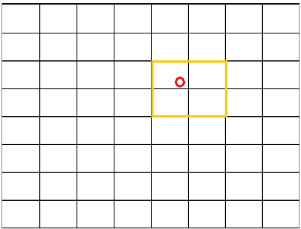
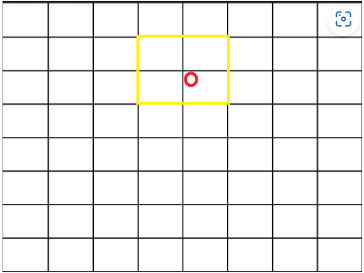
Future work
Use TOF to determine whether the hand is forward or backward
Work on unity instead of python
More precious
Depth of each finger judgment

Slide 15
Test
Method: Mediapipe + TOF
Step: Camera -> Mediapipe model + TOF information -> Reconstruct hand in Unity
Result: Finger curving is now functioning correctly, but rotation still needs to be fixed.

